Slide 1
Predictive modelling presentation
Telecom customer churn prediction
Team – ISSSR

Slide 2
Identifying the indicators that will help predict if a customer will churn from the company or not
Background
Telecom Churn is becoming an increasingly significant problem today. With lots of carriers having promotions in terms of data, new phone and multiline it is becoming increasingly difficult to keep a customer engaged
Problem Statement
Around 7K customers have been identified where around 25% of customers churn. Based on information regarding customer related information , we need to predict if a customer will churn or not and determine what are the factors that cause him to churn
Data availability
The dataset was obtained from the IBM sample dataset repository that is commonly used for building models. The dataset is at a customer level , with 23 customer attributes. There is no out of time dataset to score for this problem.

Slide 3
Steps carried out for factor analysis of churned customers vs non churned customers
Second Step
Fourth Step
Feature engineering and Model Generation
Insights Generation and next steps
First Step
Data cleaning and Hypothesis building
Third Step
Model validation
and fine tuning
Treating Missing values and Invalid records
Exploratory data analysis
Outlier treatment
Transform and adding new indicators
Feature generation
Baseline model
Machine learning algorithms
Scoring and Validating the model for best fit
Attempt ways to minimise misclassification rate
Provide Insights and Recommendation
Identify ways to improve upon existing model

Slide 4


I. Data cleaning and EDA
Exploratory data analysis was conducted to come up with high level insights about the business
Customer factors
$
Online
security
Partner / Dependents
Streaming TV / Movies
Online backup
Tech
Support
Payment method
Paperless
billing
Multiple
lines
Tenure
Data structure
Data imputation
Data partitions
80%
Categorical
80%
Training
99%
20%
Numeric
Missing
Rows
Total Charges
NA
20%
Testing
0%
0.5%
Hypothesis and model building was done on training set
Testing dataset was used to evaluate the model to remove overfitting and generalizability
Total charges were null for customers who had 0 tenure. Hence, Imputed to 0

Slide 5
I. Data cleaning and EDA
Bivariate analysis gives an indication about some possible characteristics of churn behavior
# OF CUSTOMERS
CHURN
%

Slide 6
I. Data cleaning and EDA
Bivariate analysis gives an indication about some possible characteristics of churn behavior
# OF CUSTOMERS
CHURN
%
It is observed that Customers who don’t opt for online security, have electronic check payment method, don’t have tech support and are on a month to month contract are likely to churn
These customers also represent a sizeable chunk of the customer base

Slide 7
II. Model Building
For logistic problems, categorical variables are said to have highest predictive power. We validate using WOE and build our baseline model
WEIGHT OF EVIDENCE
MODEL RESULTS
Variable | Variable importance
Contract | 1.188434
M2M | 1.043467
tenure | 0.797388
Contract_2Y | 0.79628
NoFibreOptic | 0.762879
TechSupport | 0.710629
OnlineSecurity | 0.709078
InternetService | 0.673835
TechSupport_No | 0.646902
Fiber optic | 0.569696
OnlineBackup | 0.538982
DeviceProtection | 0.514396
PaymentMethod | 0.450602
PM_ElectronicCheck | 0.444976
MonthlyCharges | 0.42982
 | Estimate | Std. Error | z value | Pr(>|z|)
(Intercept) | -2.8509 | 0.229323 | -12.432 | < 2e-16
tenure | -0.01623 | 0.004351 | -3.731 | 0.000191
Contract with Month to Month | 1.877343 | 0.236394 | 7.942 | 2.00E-15
FiberOptic Internet | 1.240954 | 0.083523 | 14.858 | < 2e-16
PaperlessBilling_Yes | 0.515963 | 0.084045 | 6.139 | 8.30E-10
Electronic check Payment | 0.577782 | 0.078116 | 7.396 | 1.40E-13
Tenure + Contract_MM | -0.02058 | 0.004942 | -4.163 | 3.14E-05
Confusion Matrix
 | Predict Churn | Predict Active
Actual Churn | 156 | 311
Actual Active | 82 | 1212
Misclassification rate
20%
AUC Statistic
0.833
Contract type of a customer is crucial to determine if a customer will churn
Customers who prefer electronic means ( such as paperless billing , electronic means and fibre net) churn a lot

Slide 8
III. Model Fine tuning
Feature engineering proved to be important in a dataset with minimum variables. Additional features will be useful for different models
Variable enhancement
Alternate models
Categorical variables were converted to indicator variables in order to study if there are interaction effects. For ex. The effect of a particular variable occurring more in a year
Math transformation was used to get best representation of features
Apart from logistic regression, we have with us , the disposal to employ a wide variety of machine learning algorithms, in order to boost accuracy
GBM
SVM
RF
NN
Payment *Tenure *Multiline
RF
NBC
GBM
NN
NN
Tanh Square Cube Log Exponential
RF
(Tenure , Total charges, Monthly charges)
GBM
Machine learning models can be evaluated individually and as well as combined into an ensemble

Slide 9
III. Model Fine tuning
Grid search was employed in order to get the best possible hyper parameters for Random forest and Gradient boosting machine
Random
Forest
max_depth | mtries | ntrees | logloss | AUC
7 | 7 | 500 | 0.410149 | 0.83452
8 | 5 | 1000 | 0.41023 | 0.83345
7 | 7 | 1000 | 0.410277 | 0.83138
AUC Statistic
0.834
Grid search was applied to get the variable sampling rate and maximum depth. Number of trees were based on user specification
Gradient Boosting Machine
max_depth | min_rows | nbins | sample_rate | AUC
3 | 8 | 512 | 0.55 | 0.836802
6 | 256 | 64 | 0.65 | 0.83543
6 | 512 | 16 | 0.5 | 0.835386
AUC Statistic
0.836
H20 package in R uses a validation dataset to optimize for number of trees and learning rate. The rest of the parameters are user inputs

Slide 10
III. Model fine tuning
Model fine tuning was done by considering additional modelling techniques and ensembling different models together
0.8465
0.84
The models whose input was considered for ensembling
Logistic Regression
KNN algorithm
Random Forest
The best model that can be formulated is an ensemble model and that is very comparative to the performance of a logistic model
Selecting a logistic model has many advantages
It can give a under-the-hood look of which variables are important and what is its contribution to risk
It is more stable provided the Out of time validation dataset follows same distribution of training and validation dataset
Ensembled models
0.836
Logistic Regression
with interaction
0.834
Random Forest
0.82
Gradient Boosting Machine
Logistic Regression
AUC statistic

Slide 11
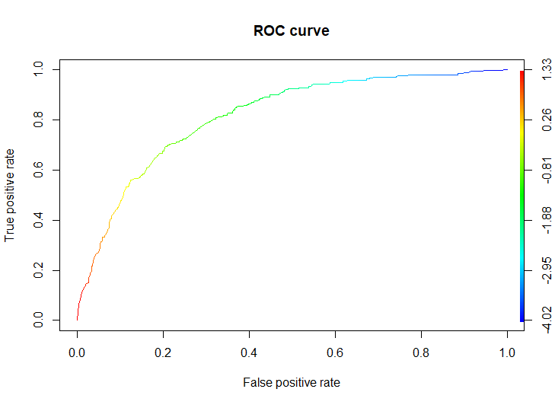
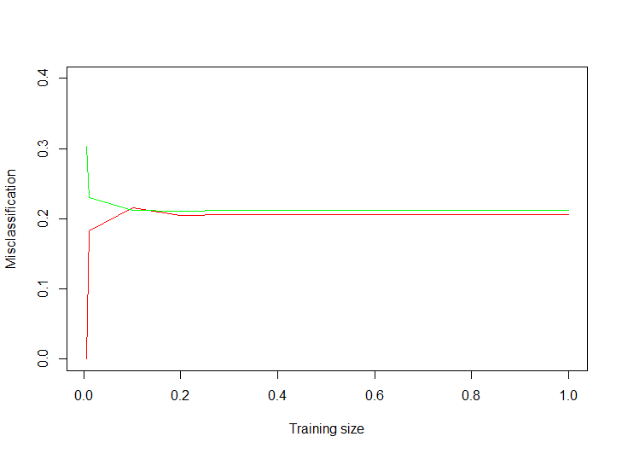
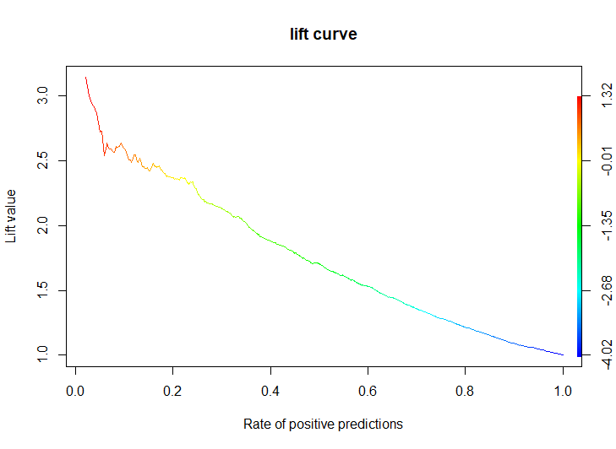
IV. Results and recommendations
Using the logistic regression model, We generate the ROC , lift as well as learning curve for this model

Slide 12
IV. Results and recommendations
Based on the model building exercise, a specific set of profiles have been constructed for a churned customer and non churned customer
Fibre optic connection enabled
Tenure
12 years
No Fibre optic connection
Tenure
2 years
80%
40%
$
$
Churned customer
Retained Customer
Electronic check payment disabled
Paperless billing enabled
Monthly contract
Paperless billing disabled

Slide 13
Next Steps
Next steps for better model accuracy statistics and having a detailed customer profile for churn
While customer specific attributes are good indicators of churn, they represent only a part of the puzzle
Customer experience with the company will be a firm determiner whether he will churn or not
Misclassification rate is high, and tendency to predict churn isn’t there. Therefore we need strong indicators of churn
Churn predictors
Location
Customer profile
Location risks that a Telecom operator may affect a customers intent to retain
Continuous monitoring of customer profile gives a realistic estimation
Competitors
Micro/macro factors
Constant monitoring of competitor presence and price monitoring
Economic conditions of customer well being

Slide 14
Thank You

Slide 15
Appendix

Slide 16
I. Data cleaning and EDA
Bivariate analysis gives an indication about some possible characteristics of churn behavior
Population
percent
Churn vs Population proportion

Slide 17
Selecting the right interaction terms were done using 3 different scenarios
Scenario 1-
Consider all variables in the model
Create interaction terms for all variables
Run stepwise regression to judge significant interaction
Scenario 2 -
Consider all variables in the model
Create interaction terms for all variables
Run lasso regression to judge significant interaction
Scenario 3 -
Consider all variables in model
Run chaid tree to judge significant interaction

Slide 18
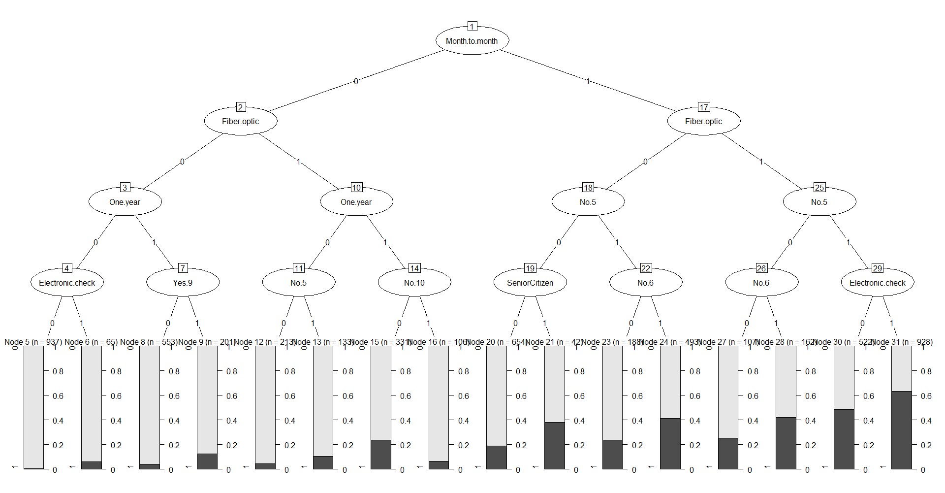
Selecting the right interaction terms were done using 3 different scenarios

